Slide 1

HOUSTON PARKS AND RECREATION DEPARTMENT
Master Plan Up-to-Date Overview Presented to Quality-of-Life Committee Kenneth Allen, Director
November 16, 2023

Slide 2
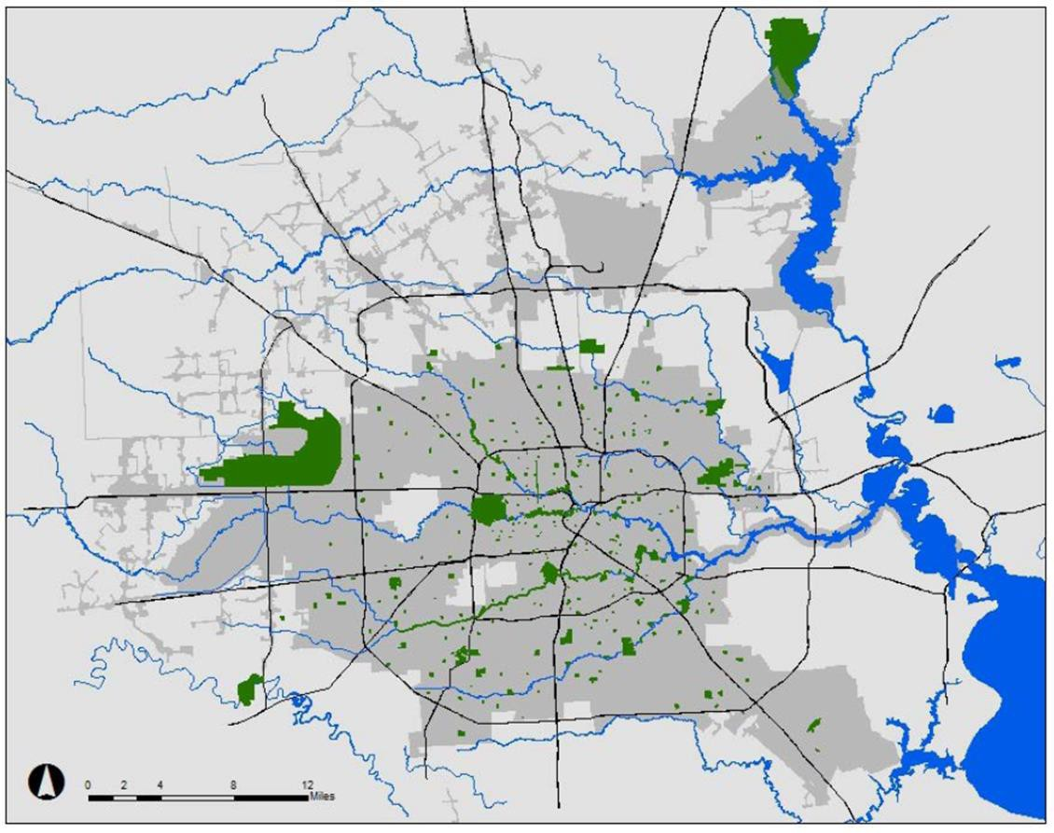

CITY OF HOUSTON PROFILE
Population: 2.3 million+ (Houston)
Size: 640+ square miles Size in acres: 409,600 acres
Population Density: 5.62/acre
Number of HPARD Parks: 382 developed parks
HPARD Park Land & Open Space: 38,486 acres

Slide 3
INTRODUCTION
Although HPARD reviews the Master Plan and its contents on an annual basis, it was important to solicit ideas and feedback from the communities that we serve, bringing the plan up-to-date. The past eight years were like no other for HPARD. Cities and park systems nationwide were severely affected by the COVID pandemic and devastating weather events and extreme drought challenges. What we found was that during the most uncertain times, Parks were instrumental to families, neighborhoods, and communities. Parks are a fundamental component to overall health and wellness. Being able to visit a safe, well-maintained park was and still is extremely important for the physical, mental and social well-being of our residents.
This plan shares our long-range strategy for the creation, optimization, and maintenance of Houston’s parks and recreation landscape, both today and beyond. With a focus on the needs and aspirations of the community, it is important that we have a current plan that addresses future needs and opportunities for maintaining, improving and diversifying the range of recreation services, facilities, parks, open spaces and trails. As we celebrate our successes and milestones achieved over the past 8 years, the Houston Parks and Recreation Department aims to make strategic parks and recreation investments working with our city leaders, community stakeholders, volunteers, and the private sector to secure the future of Houston’s park system.

Slide 4
INTRODUCTION
This presentation offers a high-level summary of the Houston Parks and Recreation
Department (HPARD) up-to-date Master Plan.
The HPARD Master Plan was adopted by City Council on October 13, 2015 (Motion 2015-0690).
The Master Plan is revisited periodically to evaluate and make recommendations based on
existing conditions, data analysis, and public input.
The City’s Park system is divided into 21 Park Sectors identified in the Parks and Open Space
Ordinance.
This plan continues as a tool within the City’s overall general planning efforts.
Following the QoL presentation, HPARD will present the up-to-date Master Plan to City Council.

Slide 5
MASTER PLAN UP-TO-DATE OVERVIEW
Since 2015, an increase of 12 parks from 370 parks to 382 parks and an increase of 627 acres
from 37,859 acres to 38,486 acres
Added amenities – 1 Sports and Recreation Center, 5 water spraygrounds, 15 playgrounds,
2 dog parks, 3 volleyball courts, 14 tennis courts, and 2 baseball/softball fields
Added up-to-date inventory that was not listed before such as – 34 outdoor exercise areas, 47 pickleball courts, 16 football fields, 15 multi-purpose fields, 2 lacrosse fields, 13 mini-pitch courts and 1 velodrome
Added the City of Houston’s Nature Preserve Ordinance and Natural Resource Projects.
Added the assessment of neighborhood parks ranked by the highest need
New park project accomplishments thru Complete Community, Mayor Love Our Park and 50/50 Initiatives.

Slide 6
PURPOSE OF THE HPARD MASTER PLAN
To serve as a decision-making guide for expanding and improving the parks system.
To ensure equitable distribution of park space for all communities.
To identify, assess, and prioritize: park inventory, recreational facilities
and programming opportunities, and conservation/land management needs by
Park Sector.
To provide parks and green spaces for citizens within a half mile or 10-minute walk from their neighborhood.

Slide 7
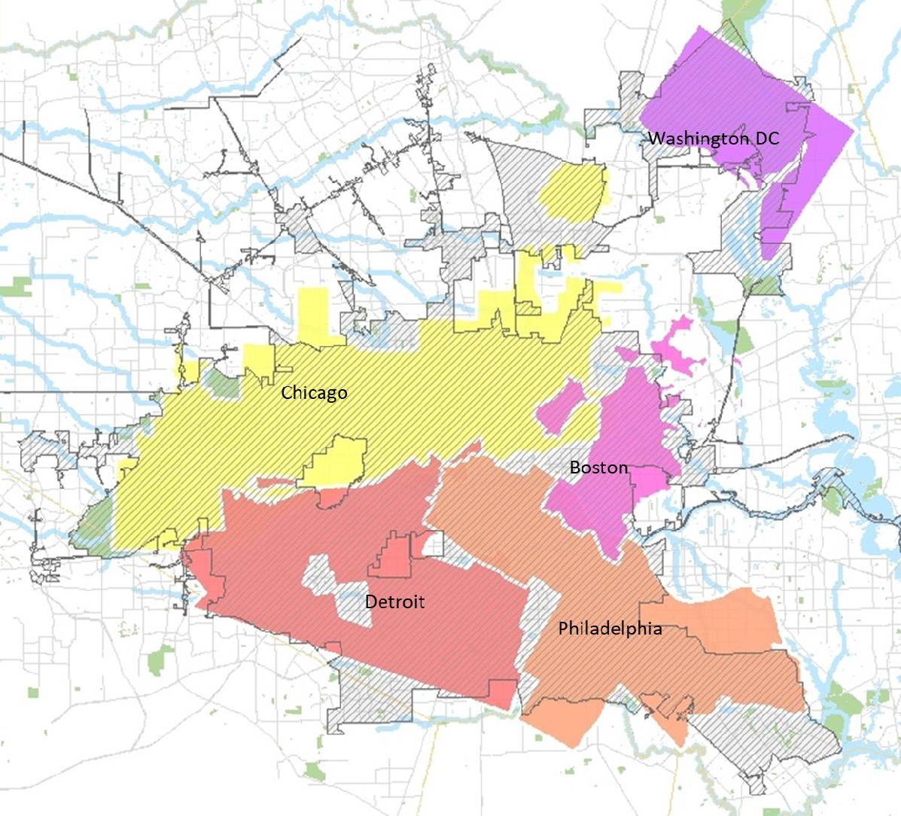
CITY OF HOUSTON
The cities of Chicago, Philadelphia, Detroit, Boston and Washington D.C., could fit within Houston’s geographic boundaries in the 640+ square miles.

Slide 8
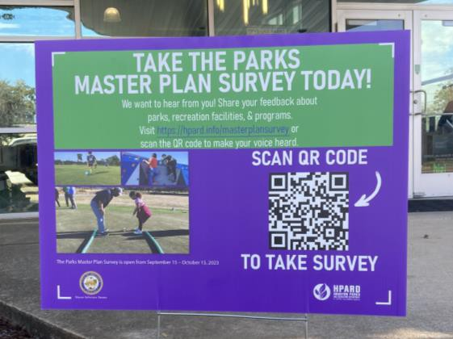
COMMUNITY INPUT PROCESS
What tools were used to engage on-going community input:
  Data collection from Capital Improvement Plan meetings in
each City Council District
  HPARD solicited Master Plan input through an online survey in the fall of 2023
  Signs with QR Codes were placed at every HPARD Community Center to promote the
survey to community members with limited internet access
  Public outreach was conducted via the HPARD website, CitizensNet, HTV, radio, and social media outlets
  An extensive community planning process as part of the Complete Communities Initiative developed Action Plans in 10 historically under-resourced neighborhoods, home to one in six Houstonians.

Slide 9
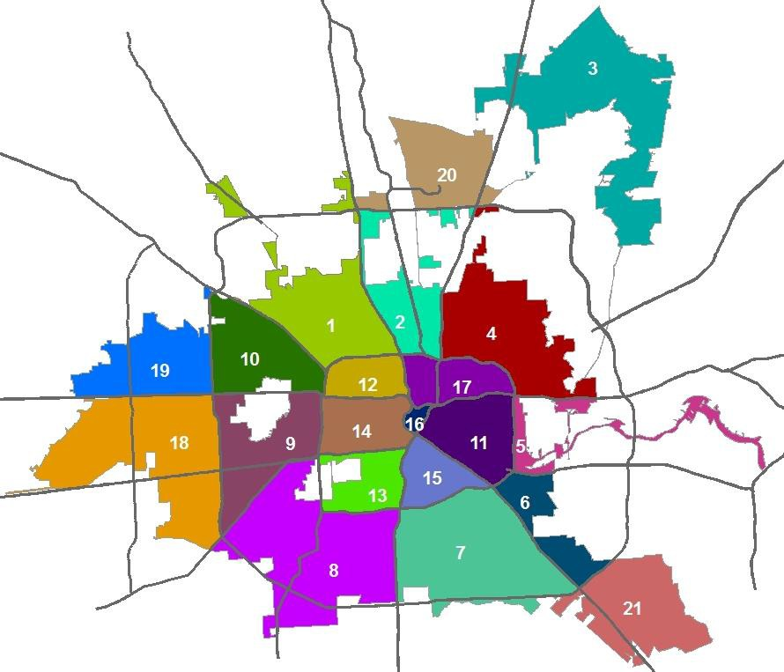
HOUSTON PARK SECTORS PROFILE
The up-to-date Master Plan continues to assess the City’s Parks system by 21 individual Park Sectors.
The City of Houston passed the Parks and Open Space Ordinance (Chapter 42: Subdivisions, Developments and Platting Ordinance 2007-1141) to better manage its large park and recreation system.

Slide 10
HOUSTON PARK SECTORS PROFILE
The Park Sectors are defined by freeways and the city limits, not by political boundaries such as Council Districts. Each Park Sector contains multiple Council Districts.
Each Park Sector report will contain up-to- date information such as:
Location/Map/Size
Population/Demographics
Council Districts
Super Neighborhoods
TIRZ/Management Districts
Number of HPARD Parks in the sector
Acres of HPARD Parkland
Project accomplishments
Council District | Park Sectors
A | 1, 10, 19
B | 1, 2, 4, 11, 17, 20
C | 1, 8, 12, 13, 14
D | 7, 8, 13, 14, 15, 21
E | 3, 5, 6, 21
F | 9, 18
G | 9, 13, 14, 18
H | 1, 2, 4, 11, 12, 14, 16, 17
I | 4, 5, 6, 7, 11, 15, 16
J | 8, 9, 18
K | 8, 13

Slide 11
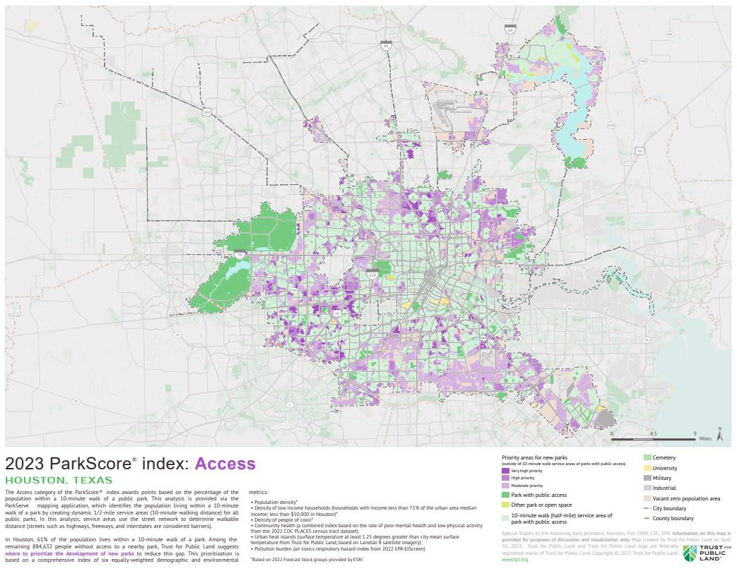
PARK SECTOR SERVICE AREAS
The Trust for Public Land (TPL) provided maps that align with our Park Sectors to illustrate which communities have a park within a 10-minute (half-
mile) walk from their home.
How to interpret each Sector Map: The purple areas indicate high priority for new
parks. These areas do not have park access within a 10-minute walk. The darker the shade
of purple signifies highest need.

Slide 12
PARK INVENTORY AND AMENITIES
Parks (Developed) | 382
Community Centers | 60
Adaptive Recreation Center | 1
Sports and Recreation Center | 1
Swimming Pools | 38
Water Spraygrounds | 28
Playgrounds | 239
Picnic Pavilions | 147
Trails | 196.81 miles
Water Body Lake / Ponds | 32
Outdoor Exercise Area | 34
Outdoor Basketball Courts | 173
Indoor Basketball Courts | 21
Indoor Basketball Goals | 74
Golf Course | 7
Disc Golf Course | 5
Skate Parks | 6
Dog Parks | 10
Tennis Courts | 220
Volleyball Courts | 20
Pickleball Courts | 47
Baseball Field (Lit & Unlit) | 114
Softball Field (Lit & Unlit) | 47
Practice Backstops Fields | 76
Soccer Field (Lit & Unlit) | 86
Cricket Field (Lit & Unlit) | 1
Football Field (Lit & Unlit) | 16
Lacrosse Field (Lit & Unlit) | 2
Mini-Pitches Court | 13
Multi-Purpose Field | 15
Velodrome | 1

Slide 13
PARK CLASSIFICATIONS AND STANDARDS
Pocket Parks (less than one acre)
Play area, picnic tables, gazebo or garden
Neighborhood Parks (1-15 acres)
In addition to Pocket Park list add open space, natural habitat, walking trails, multi-use courts, practice
sports fields and covered picnic shelters
Community Parks (16-150 acres)
In addition to Neighborhood Park list add lighted practice or game fields for sports, swimming pool or sprayground, recreation center, group picnic facilities, tennis/pickleball courts, parking lot and screened portable toilets
Regional Parks (151+ acres)
In addition to Community Park list add lighted sports complexes, concession stand, restrooms, golf course, tennis center, natatorium, covered basketball pavilion, multi-purpose and senior centers, nature areas and horticulture centers

Slide 14
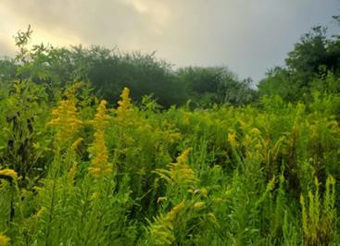
NATURAL RESOURCES PROJECTS
Riparian Restoration Projects
Future Riparian Restoration Projects
Urban Gardens
Nature Preserves
Prairie Restoration Projects
Green Stormwater Infrastructure
Other Natural Resource projects

Slide 15
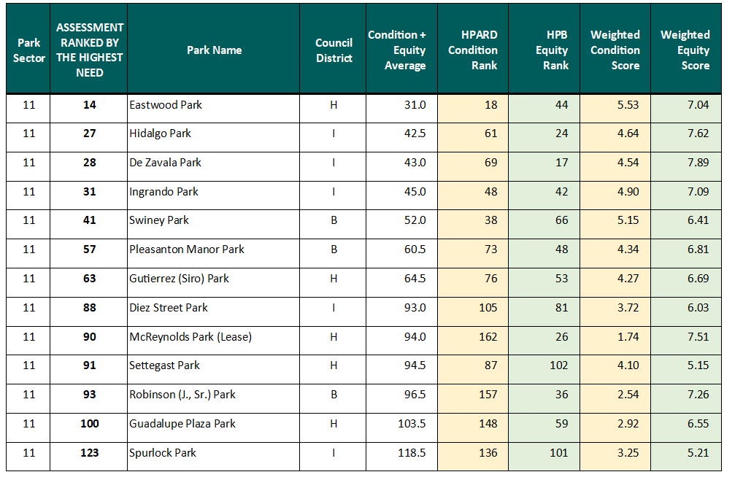
ASSESSMENT OF NEIGHBORHOOD PARKS
186 Neighborhood Parks (1-15 acres) were scored and ranked by the Houston Parks and Recreation Department (HPARD) and the Houston Parks Board (HPB).
Example of Park Sector 11:
Park conditions were ranked based on:
  Safety
  Amenities
  Accessibility
Park equity was assessed by:
  Demographics
  Social vulnerability
  Health indicators
A combined overall score was given to determine the highest need parks.

Slide 16
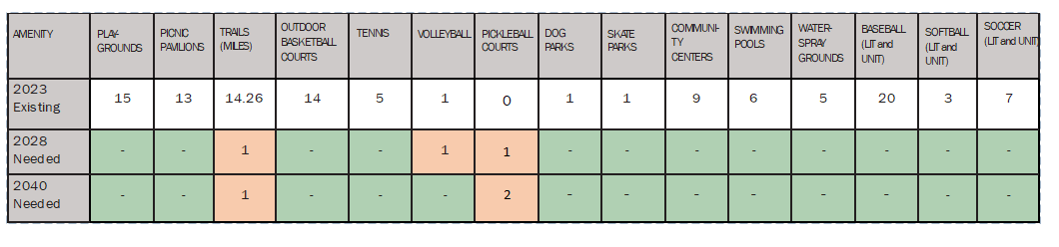
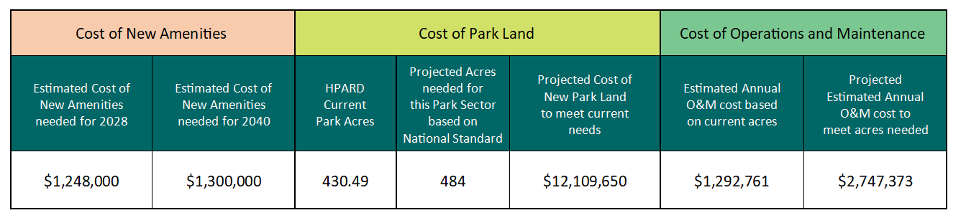
NEEDS ASSESSMENT AND COST ESTIMATES
Example of Park Sector 11:
NEEDS ASSESSMENT FOR AMENITIES
ESTIMATED COST OF NEW AMENITIES, PARK LAND, AND MAINTENANCE

Slide 17

MOVING FORWARD
Continue delivering on the priorities outlined in the Park Master Plan
Acquire park land in under-resourced areas per our Park Sector needs assessment
Leverage public funding with private investments focusing on revitalizing neighborhood parks and providing accessible and affordable recreation programs for the community
Protect and preserve our natural areas and open space for the benefit of a resilient and green Houston
Enhance visitor experience through the Keep Our Parks Safe and Clean Campaign

Slide 18
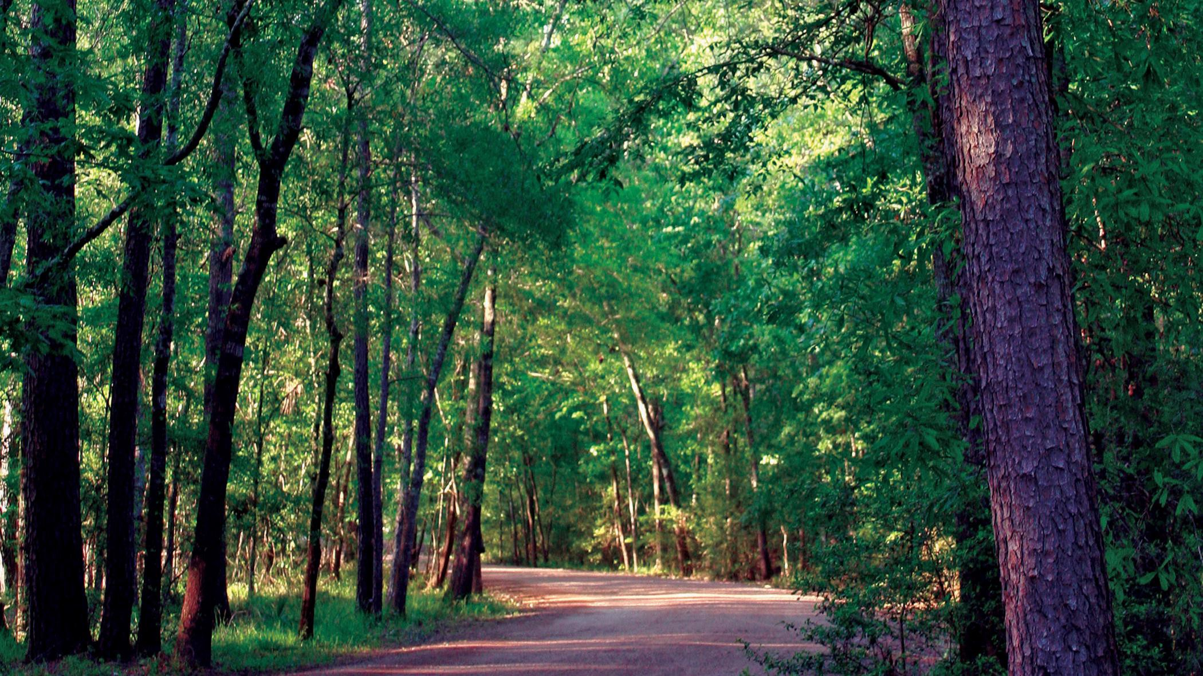




THANK YOU

