Slide 1

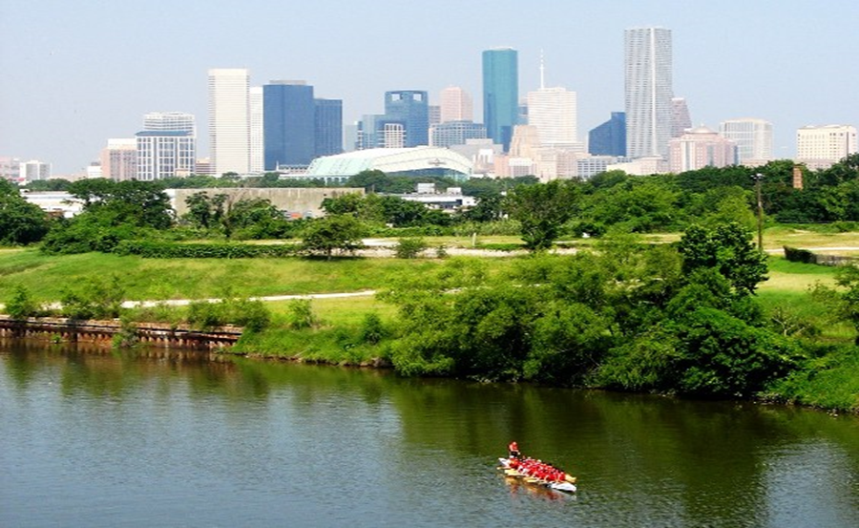
Municipal Setting Designations
Mark A. Wooten Jr.
Program Manager

Slide 2
What is an MSD?
A voluntary deed restriction that prohibits the use of impaired groundwater as potable water
    A tool property owners can use to address environmental impairments to groundwater
    Allows reinvestment and redevelopment of impaired properties
A public health protection

Slide 3
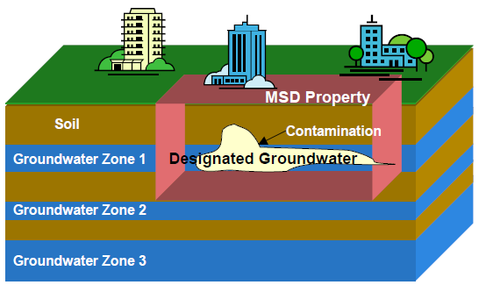
MSD Depiction

Slide 4
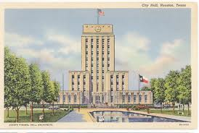
What is an MSD?
It is a State Program
    Administered by the Texas Commission on Environmental Quality (TCEQ)
    Requires Local Support
Article 13 of Chapter 47
    Public Hearing Required

Slide 5
7010 Mykawa Road

Slide 6
Ashland LLC
  8.8 acres
  1981-1992 – operated by Unocal
  Historical releases occurred
  Railcar unloading area
  Drumming dock area
  Former underground spill containment
  1992 – Ashland acquired
  1996 – sold to J.A.M Distribution
  Voluntary Cleanup Program 2002

Slide 7
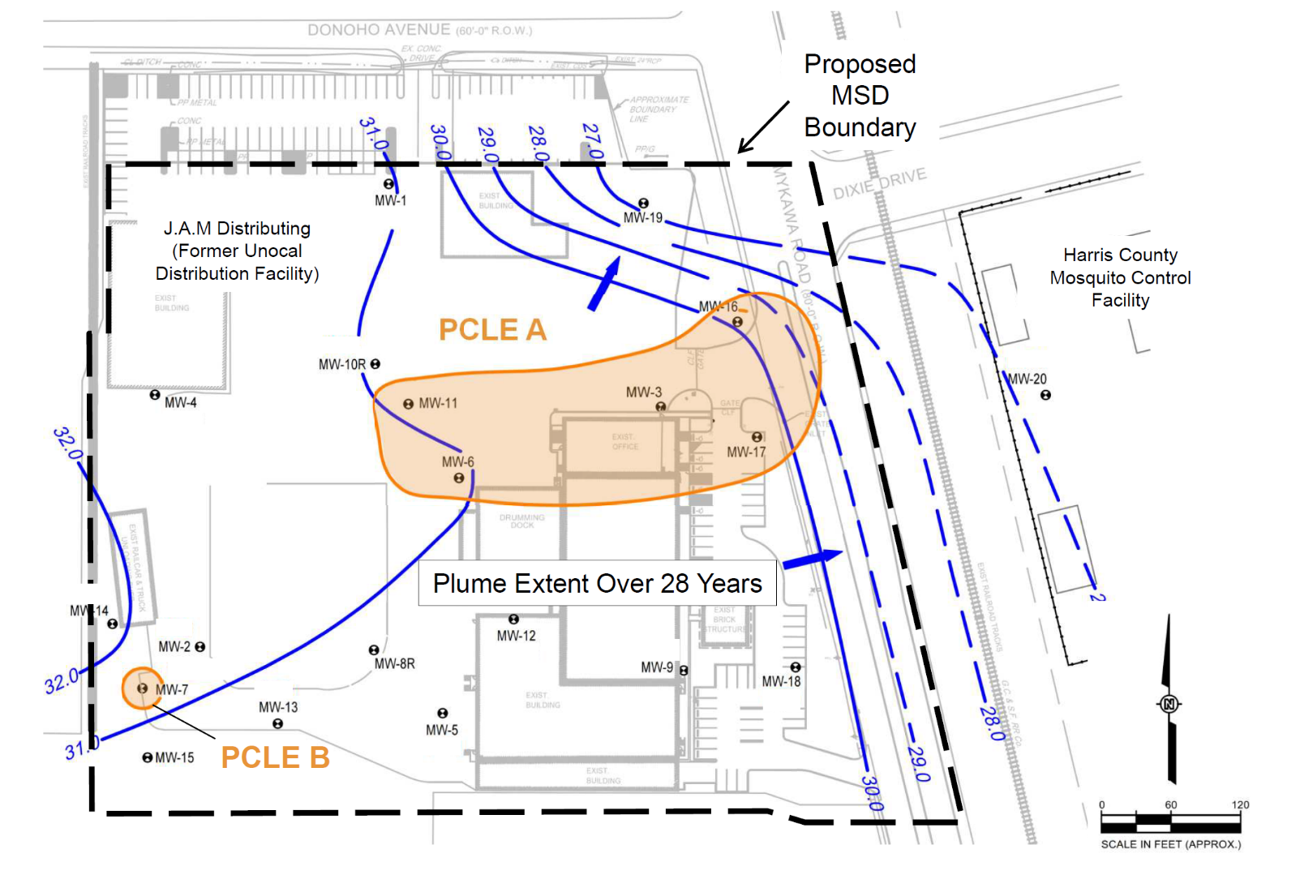
Groundwater Impacts

Slide 8
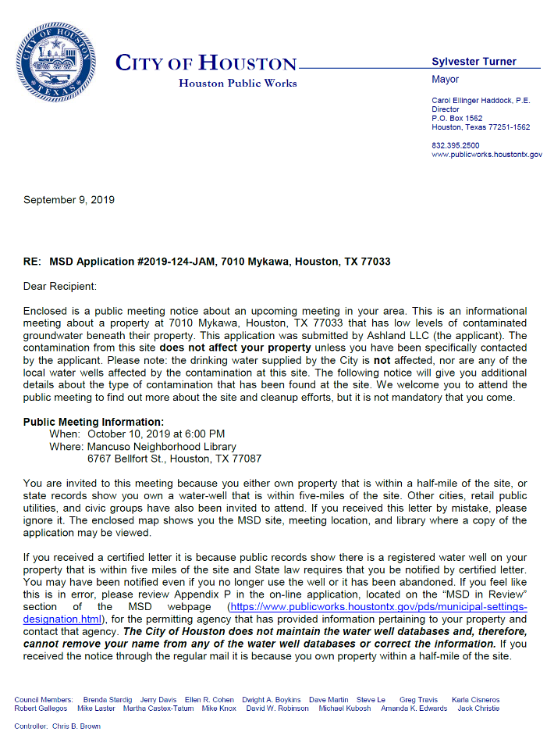
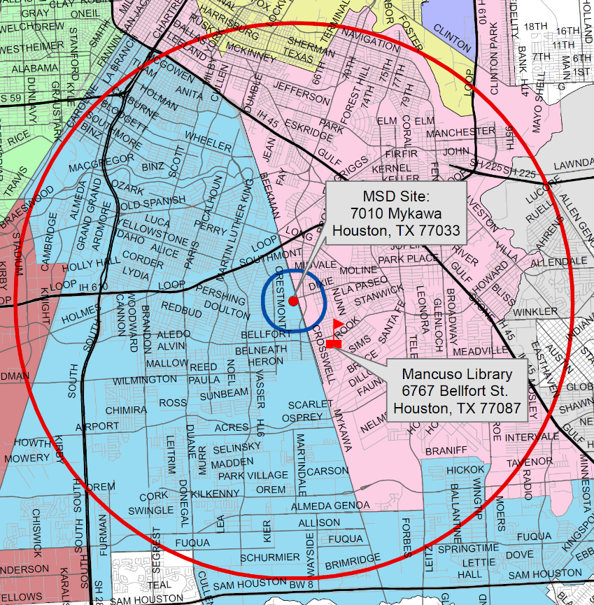
MSD Notice Letters
Property Owners
First-Class Mail
½-Mile Radius
City Requirement
Water Well Owners
Certified Mail
5-Mile Radius
State Requirement

Slide 9
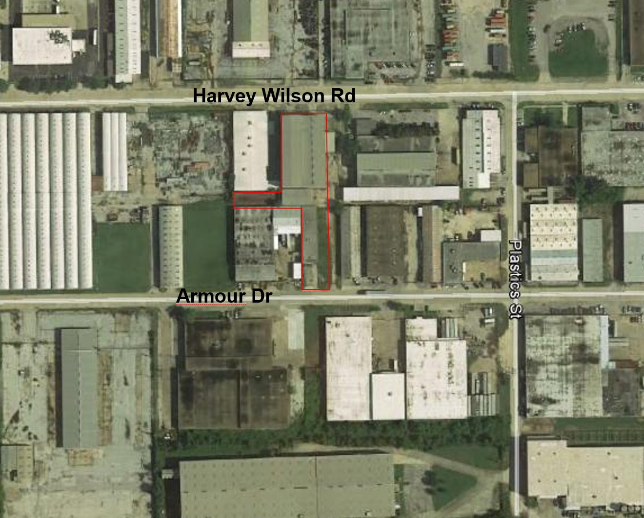
5532 Harvey Wilson Rd, 5531/5533 Armour Dr

Slide 10
Barclay Properties, LLC
  1.435 acres
  Historically occupied by the Former Wire Rope Warehouse
  Warehouses occupied by various companies over the years – several which wound wires around spools
  No known manufacturing activities were conducted on the property
  Source of chlorinated solvents is unknown
  Voluntary Cleanup Program 2017

Slide 11
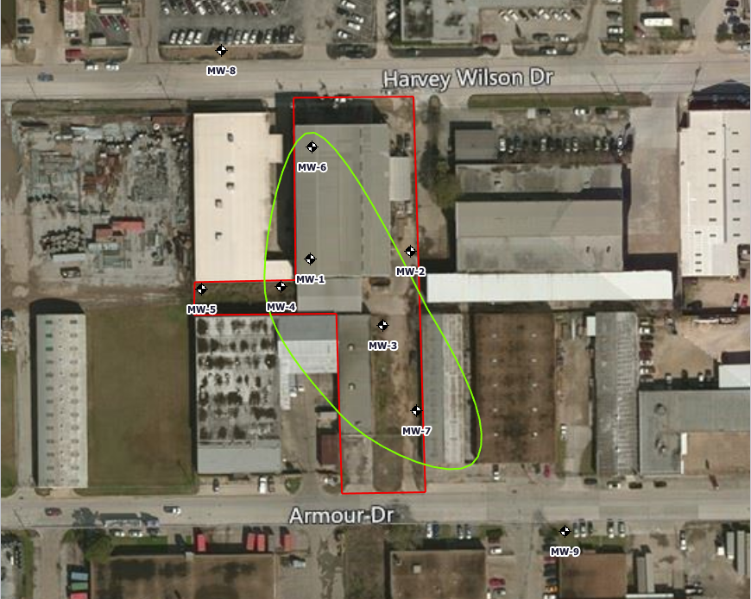
Groundwater Impacts

Slide 12
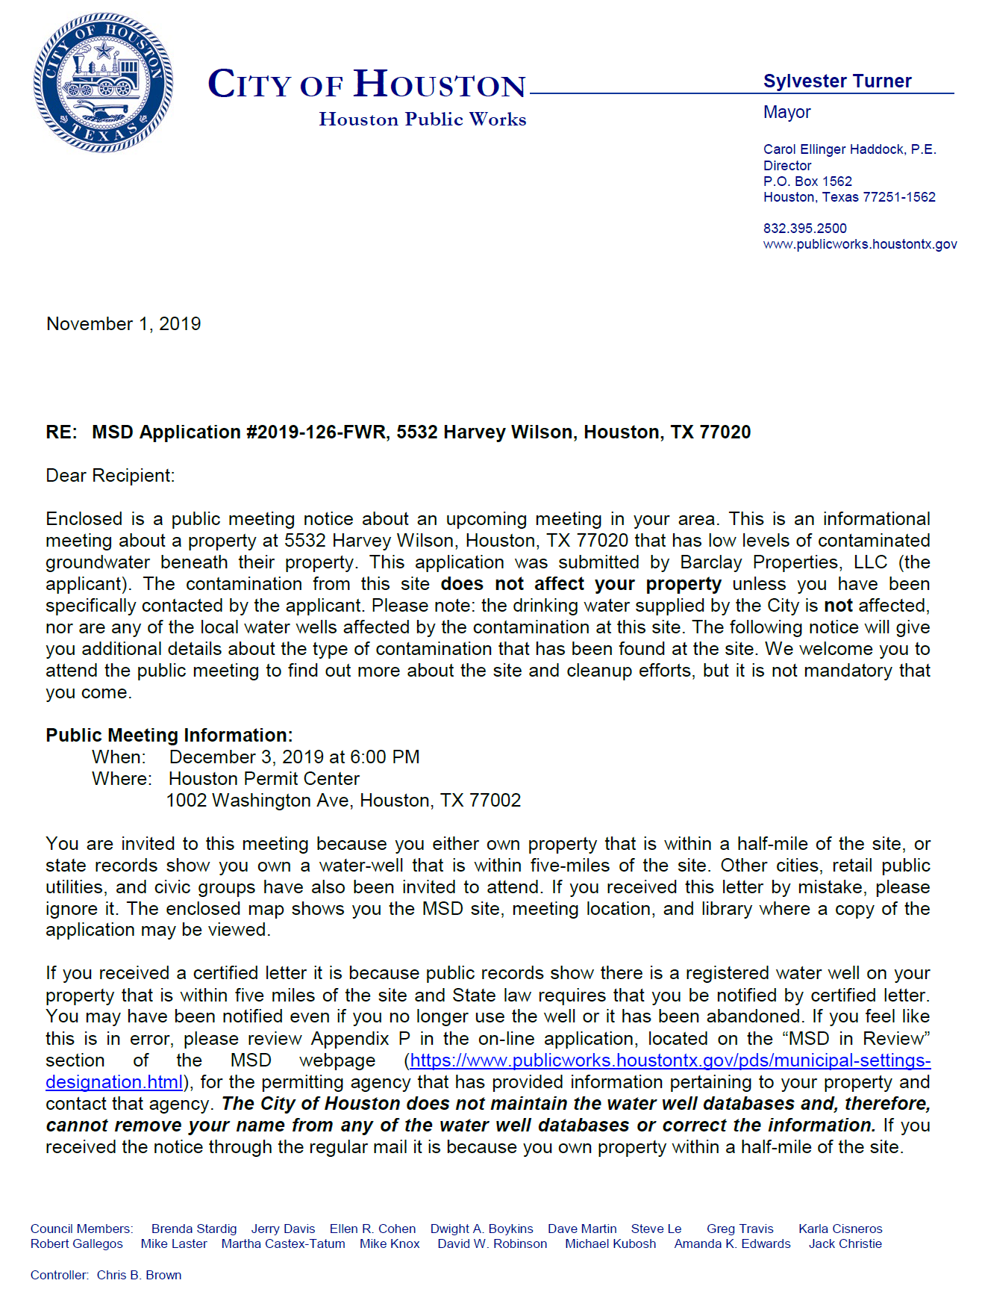
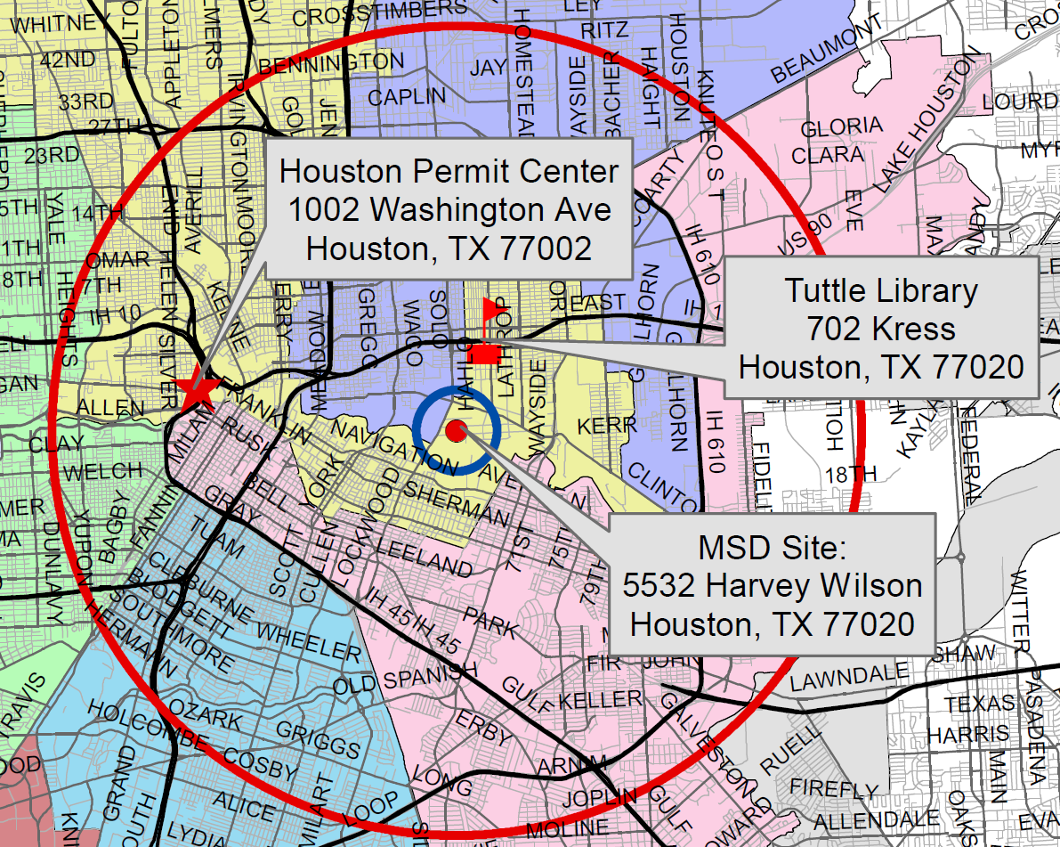
MSD Notice Letters
Property Owners
First-Class Mail
½-Mile Radius
City Requirement
Water Well Owners
Certified Mail
5-Mile Radius
State Requirement

Slide 13
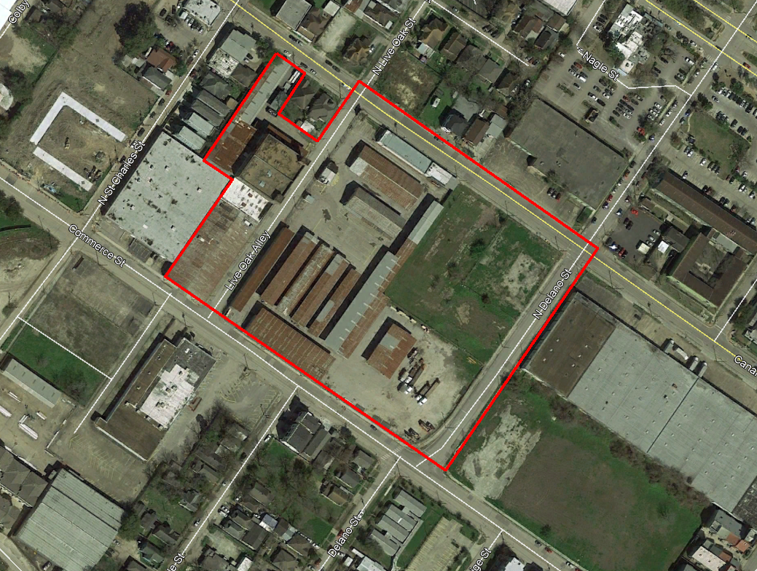
0-2714 Canal, 0-2611 Commerce,
15-41 Live Oak, 0-27 N. Delano

Slide 14
BFH Ranching, Ltd.
  9.676 acres
  Tracts 2 & 3 occupied by Olshan Lumber Company
  Olshan tracts developed in the 1920s
    Lumber yards, filling station, automotive repair facility,
    Box manufacturing, shoe shop, packing, storage and oil field supply company
  Tracts 4 undeveloped
  Tracts 6 commercially developed 1930s
  Dry cleaning facility, roofing companies, insecticide
  manufacturer, motor freight station
  Voluntary Cleanup Program 2018

Slide 15
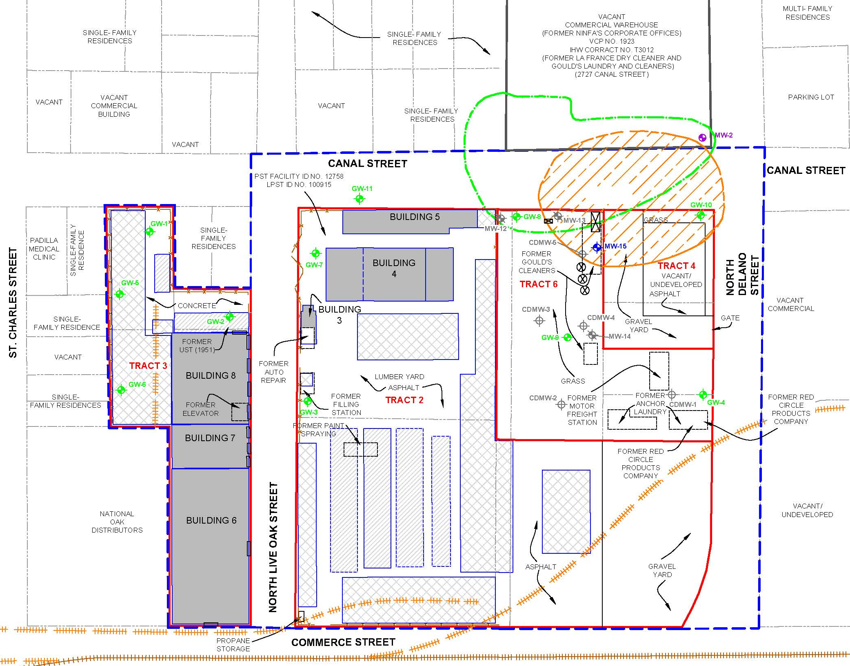
Groundwater Impacts

Slide 16
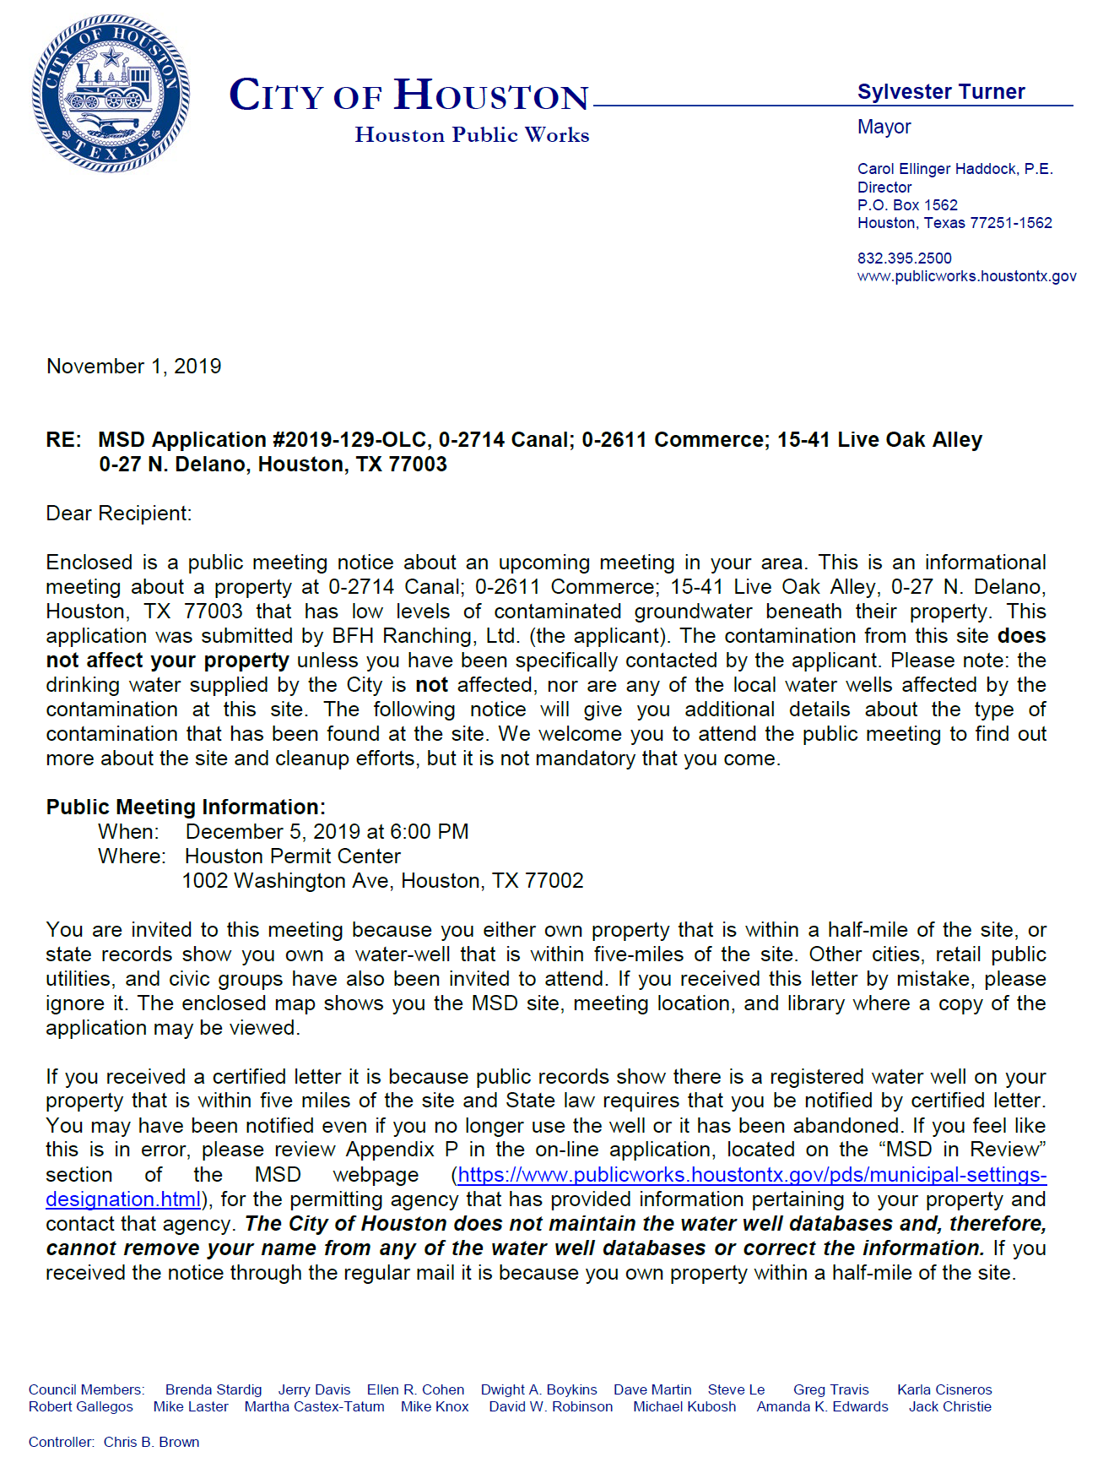
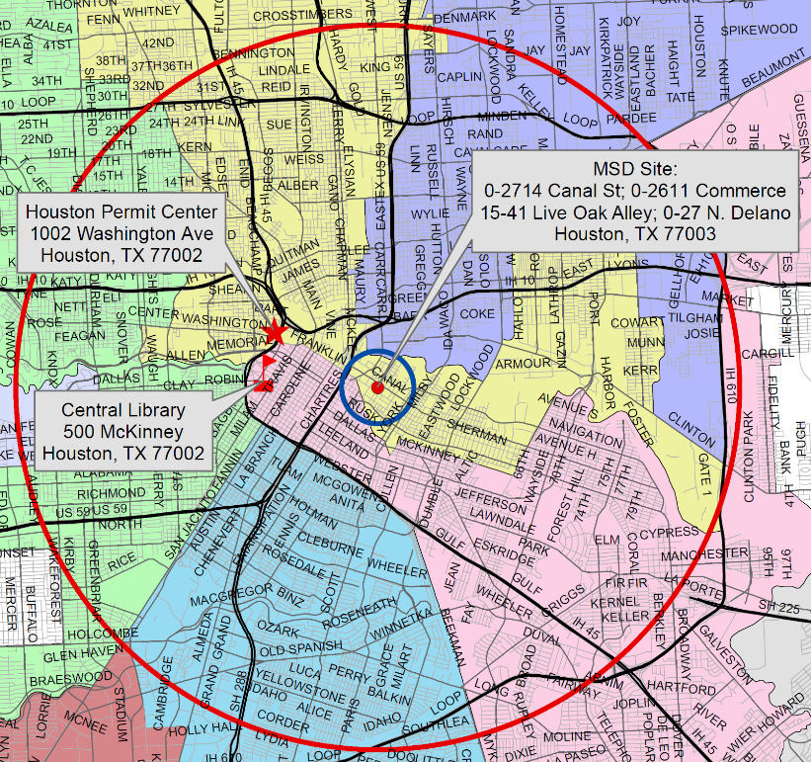
MSD Notice Letters
Property Owners
First-Class Mail
½-Mile Radius
City Requirement
Water Well Owners
Certified Mail
5-Mile Radius
State Requirement

Slide 17
Contact Information
Mark A. Wooten Jr.
Program Manager
Houston Public Works
1002 Washington, 3rd Floor
Houston, Texas 77002
msd@houstontx.gov
(832) 394-9003

